Slide 1

Blockchain Platforms: A Technical Comparison
This report compares Ethereum, Hyperledger Fabric, and R3 Corda. We will examine their technical capabilities. We will also highlight their strengths and weaknesses. These platforms are crucial for decentralized applications.
by Mahima Saxena

Slide 2

Ethereum: Public and Permissionless
Ethereum uses Proof of Stake (PoS) for consensus. This makes it more scalable. It is also energy-efficient. Developers use Solidity for smart contracts. This enables decentralized applications (dApps). Its main chain processes around 30 transactions per second. All data is globally visible.

Slide 3

Hyperledger Fabric: Private & Permissioned
Consortium Framework
Smart Contracts
Hyperledger Fabric is a Linux Foundation framework. It offers a modular architecture. This includes pluggable consensus and identity.
It supports Chaincode for smart contracts. Developers can use Go, Java, or Node.js. This offers flexibility.
Data Privacy
Data uses private channels. Information is shared on a need-to-know basis. Transactions exceed 1,000 TPS. This is limited by scale.

Slide 4
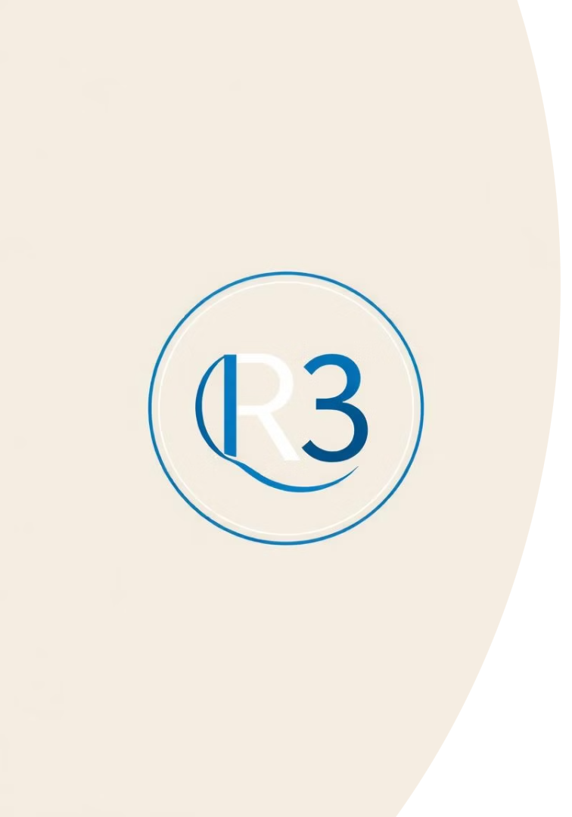



R3 Corda: Business-Oriented Blockchain
Regulated Markets
Corda is open-source. It's built for regulated markets. It ensures high security.
CorDapps
Smart contracts are "CorDapps". They are written in Java or Kotlin. This simplifies development.
Notary Service
A notary service validates transactions. Data is peer-to-peer. It's shared on a need-to-know basis. Corda scales to thousands of TPS. Its network size can be a limiting factor.

Slide 5
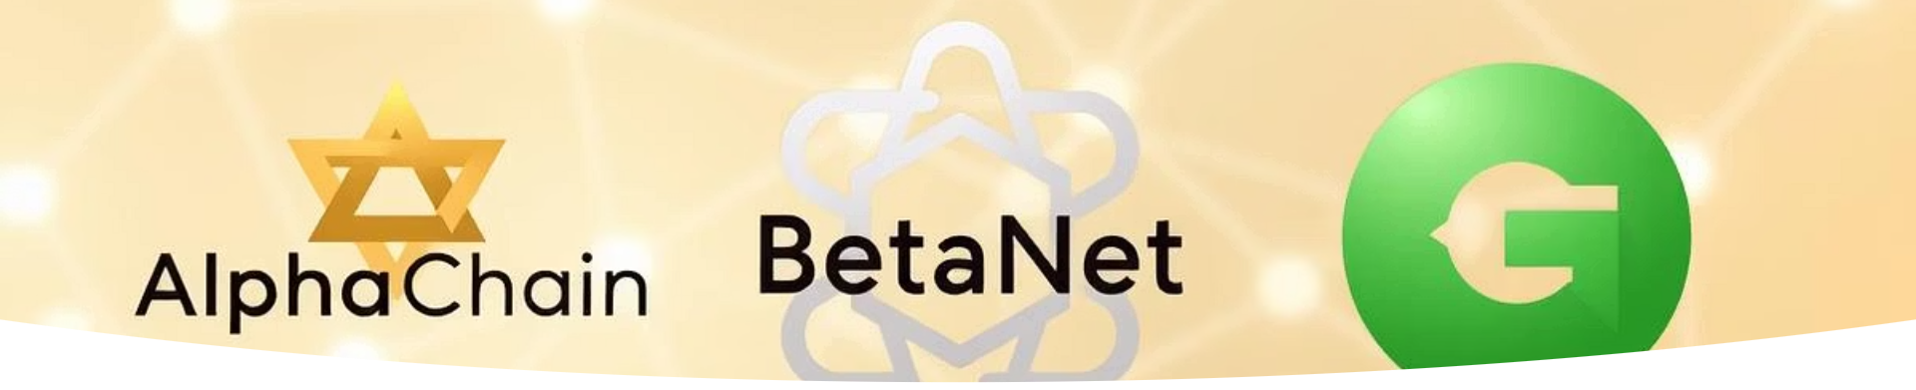
Conclusion: Choosing the Right Platform
Ethereum
General-purpose dApps
Open, public network
Hyperledger Fabric
Enterprise-grade private
Modular, private channels
R3 Corda
Regulated industries
Data privacy, peer-to-peer
There is no "one-size-fits-all" solution. Platform choice depends on specific requirements. Consider your needs carefully. Each platform has distinct advantages. Tailor your decision to your project.

